Slide 1
Group 10
40 years of Apple, Inc (APPL) stock market trends in Gains & Losses

Slide 2
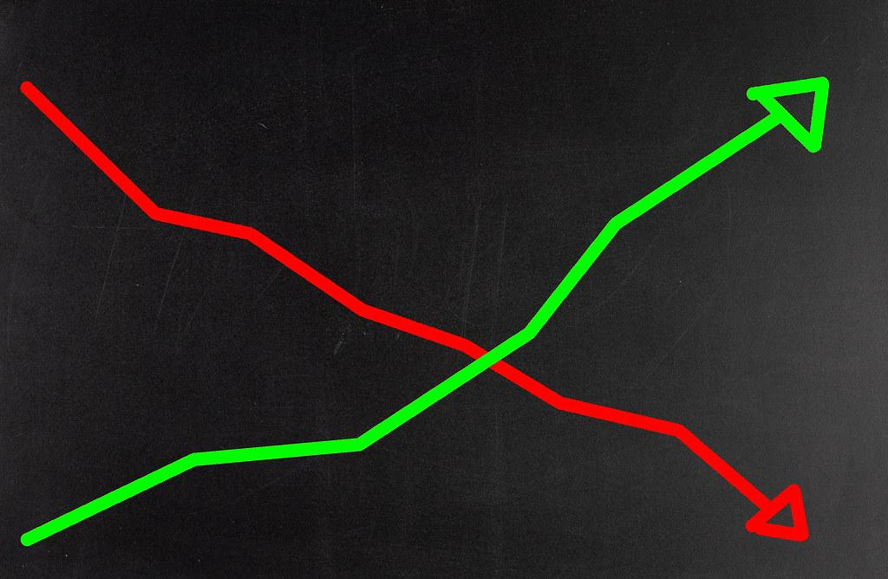
Content
Selected Topic
Reason they selected the topic
Description of the source of data
Questions they hope to answer with the data

Slide 3
Selected Topic
As it relates to human behavior, how do seasons, fiscal quarters, months, and even years compare in gains and losses, using Apple, Inc (APPL) stock?

Slide 4
Why this topic?
This topics was chosen to demonstrate that stock behavior are cyclical, and how human behavior and social events are well demonstrated within the stock market. As a result, we wish to show how we can take this information and better predict our buy and sell options using the Apple, Inc (APPL) stock

Slide 5
Data Source
The dataset utilized is from Kaggle.com, titled the “NYSE”.
Link: https://www.kaggle.com/varpit94/apple-stock-data-updated-till-22jun2021

Slide 6
Questions we hope to answer
Do seasons trigger human behavior enough to show a trend in stock price gains and losses?
Do fiscal quarters trigger a trend of stress in humans that affect stock performances through gains and losses?
Do different months of the year demonstrate a social trend through gains and losses
Do years show a cyclical trend that demonstrates a natural trend with the stock market overall?

Slide 7
Description of the communication protocols
X: Gabriel
Decide the technologies to be used for each step of the project & Create Dashboard
Circle: Remi
Database Integration
Square: Ope
GitHub Repository & Presentation
Triangle: Iry
Machine Learning Model

Slide 8
Machine Learning Introduction
Preliminary data preprocessing
Preliminary feature engineering and preliminary feature selection
How was the official model decided?
How the data is split into training and testing sets
Model choice, its’ limitations, and its’ benefits

Slide 9
Preliminary Data Pre-Processing
The Data Pre-Processing was based on figuring what story we were trying to tell.
Base dataset had the following features:
Date, Open, High, Low, Close, Adj Close, and Volume
The following features were later added through a SQL join:
Season, Quarter, a 24hr change column for each price variable, and Gain_Loss column based on 24hr change is created

Slide 10
Preliminary Feature Engineering & Feature Selection
Preliminary Feature Engineering
The target column is our “Gain_Loss_<Price_Variable>” column.
This column is based off of the numbers in “<Price_Variable>_24hr_Change” column
“< 0 = ‘Loss’”
“>= 0 = ‘Gain’”
The “<Price_Variable>_24hr_Change” or “<Price_Variable>_Change” column is based on the (current price - previous day’s price) for everyday of Apple’s stock in chronological order by “Date”
Preliminary Feature Selection
Based on Machine Learning studies, the target is based on two options only.
Examples:
0 or a 1
Yes or No
Approve or Deny
Gain or Loss
The Gain/Loss of stock prices by day is the best engineered feature to base the stock’s machine learning model, because that is what is important to the people who will use it to their own benefit

Slide 11
Machine Learning Testing and Training Split
Two models were tested for Machine Learning, both Logistic Regression and Random Forest Model.
In the Logistic Regression
Random state = 1, stratify = y, and the sample consisted of 7669 rows and 17 columns of our full database set, or 7669 rows and 18 columns
In the Random Forest Model
Received a higher accuracy by 3-5% upon changing Random state from 78 to 1 in this model for all price variables, but received the best accuracy when left at 78 for the volume variable models as well as train with 80% of the data

Slide 12
Model Choice, Model Limitations & Benefits
Two Machine Learning models were tested for this data. Both Logistic Regression and Random Forest Model were great choices because everything is measured through time and time runs linear.
Officially settled on the Random Forest Model because, not only is it a regression that works well in time, but it is beneficial in weighing the importance of each feature.
Model limitations include the fact that for time, date format was not enough for the model to read. We had to convert dates to “toordinal” time in order for the machine model to interpret dates as a form of time in a language that was it’s most favorable, and that turned out to be the “toordinal” language

Slide 13
Accuracy: Logistic Regression
Price Variables:
Low = 56%
Close = 54%
High = 55%
Open = 54%
Volume Variables:
With Volume 24hr Change Column
58%
With All Price Variable 24hr Change Columns present, but no Volume Change column
58%

Slide 14
Accuracy: Random Forest Model
Price Variables:
Low = 61%
Close = 63%
High = 60%
Open = 58%
Volume Variables:
With Volume 24hr Change Column
66%
With All Price Variable 24hr Change Columns present, but no Volume Change column
72%

Slide 15
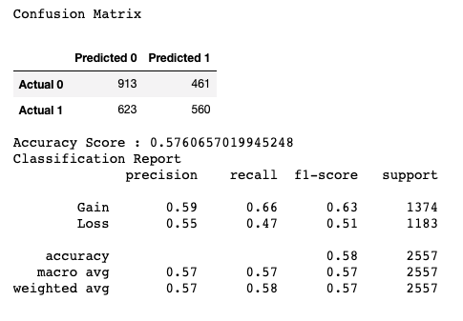
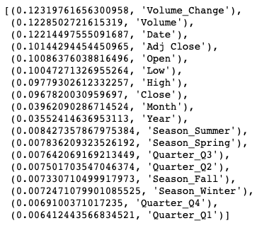
RFM Confusion Matrix & Feature Importance: Open
Open
Open

Slide 16
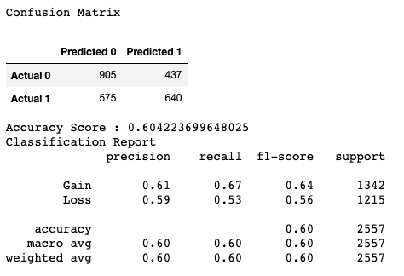
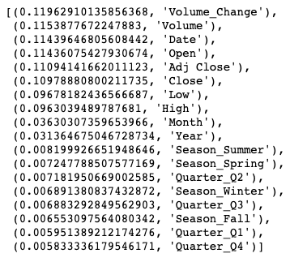
RFM Confusion Matrix & Feature Importance: Close
Close
Close

Slide 17
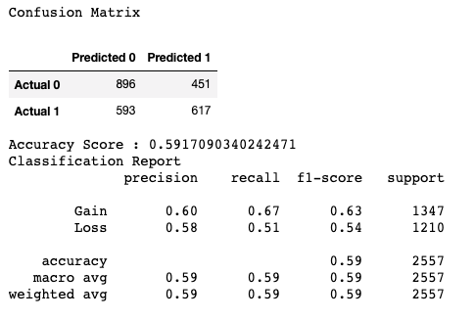
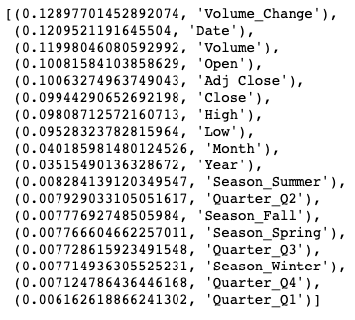
RFM Confusion Matrix & Feature Importance: High
High
High

Slide 18
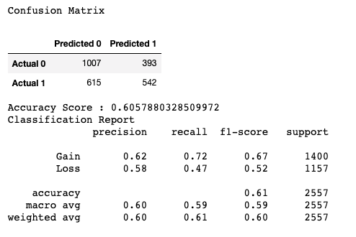
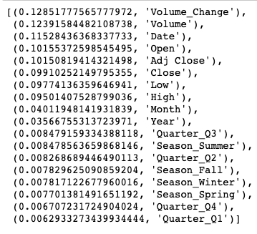
RFM Confusion Matrix & Feature Importance: Low
Low
Low

Slide 19
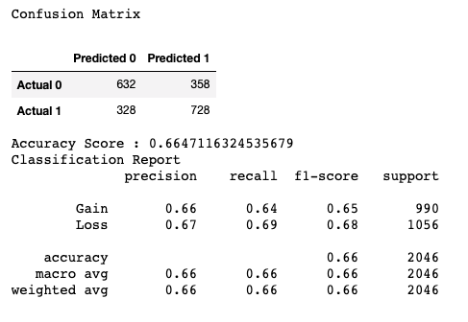
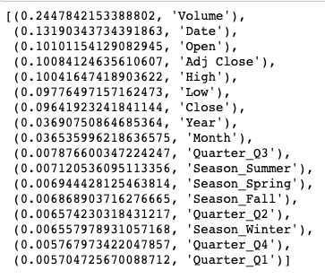
RFM Confusion Matrix & Feature Importance: Volume
Volume
Volume

Slide 20

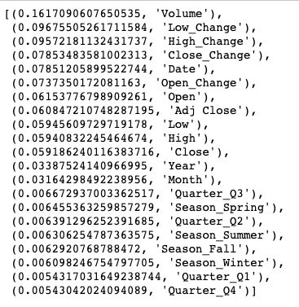
RFM Confusion Matrix & Feature Importance: Volume with 24hr Price Variable Changes
Volume with 24hr Price Variable Changes
Volume with 24hr Price Variable Changes

Slide 21
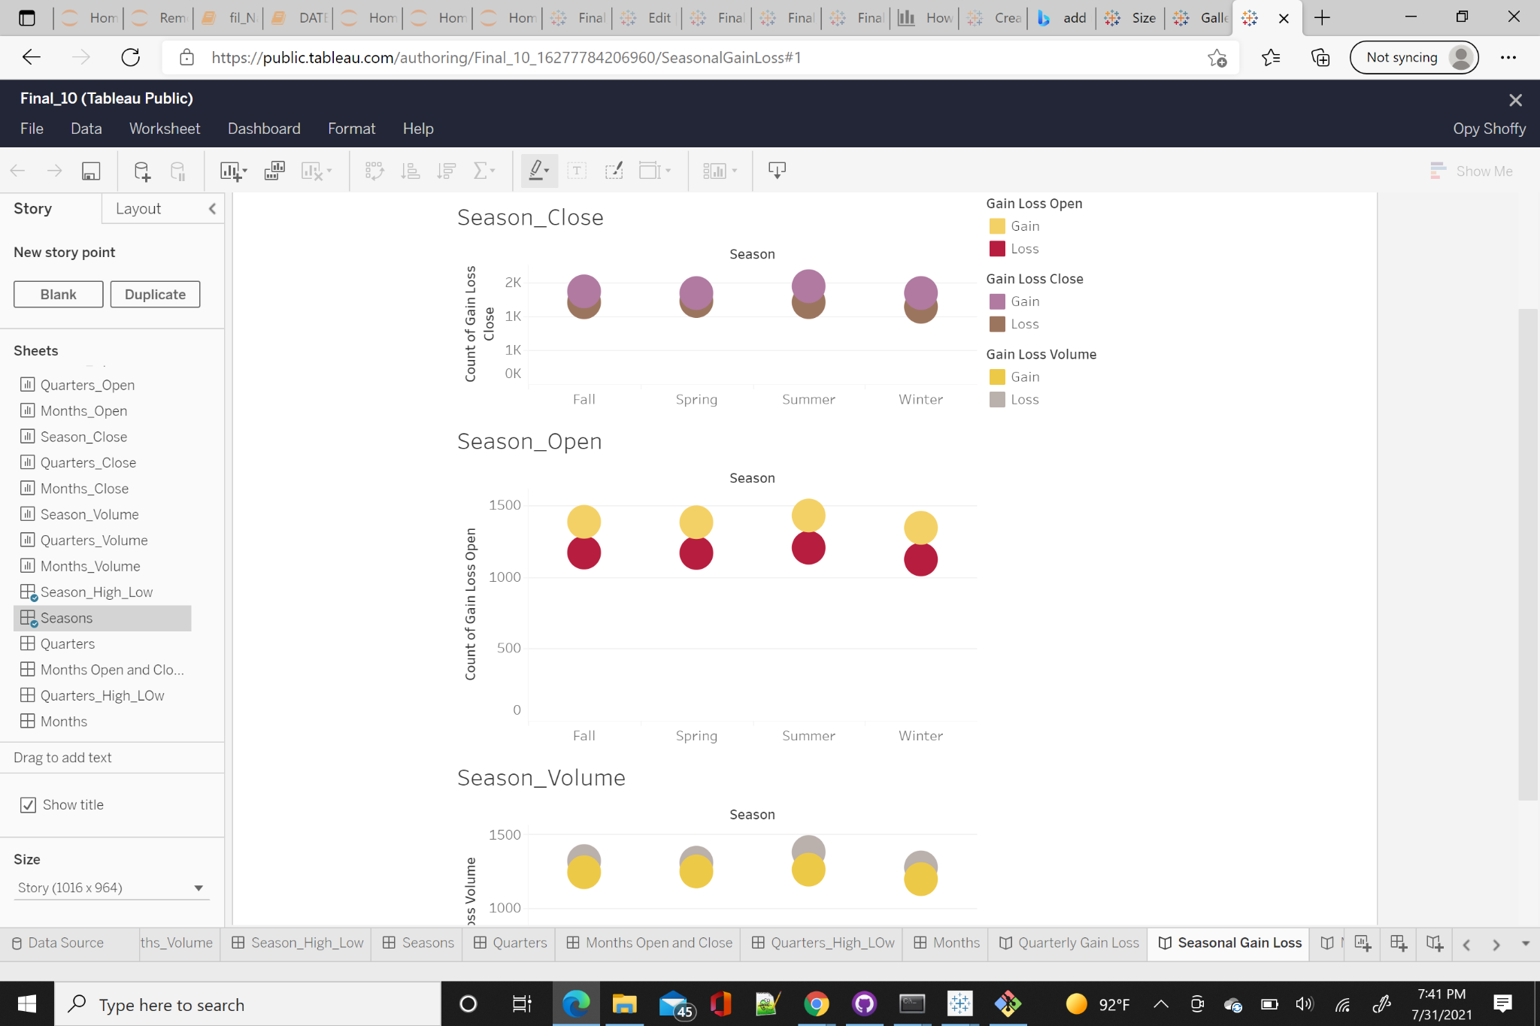
Dashboard
The dashboard contains worksheets, dashboard and stories that explains the connection between Seasonal, Quarterly and Monthly Gain/Loss. Attached is the link to the dashboard:
https://public.tableau.com/app/profile/opy.shoffy/viz/Final_Project_10_16277782240420/QuarterlyGainLoss

Slide 22
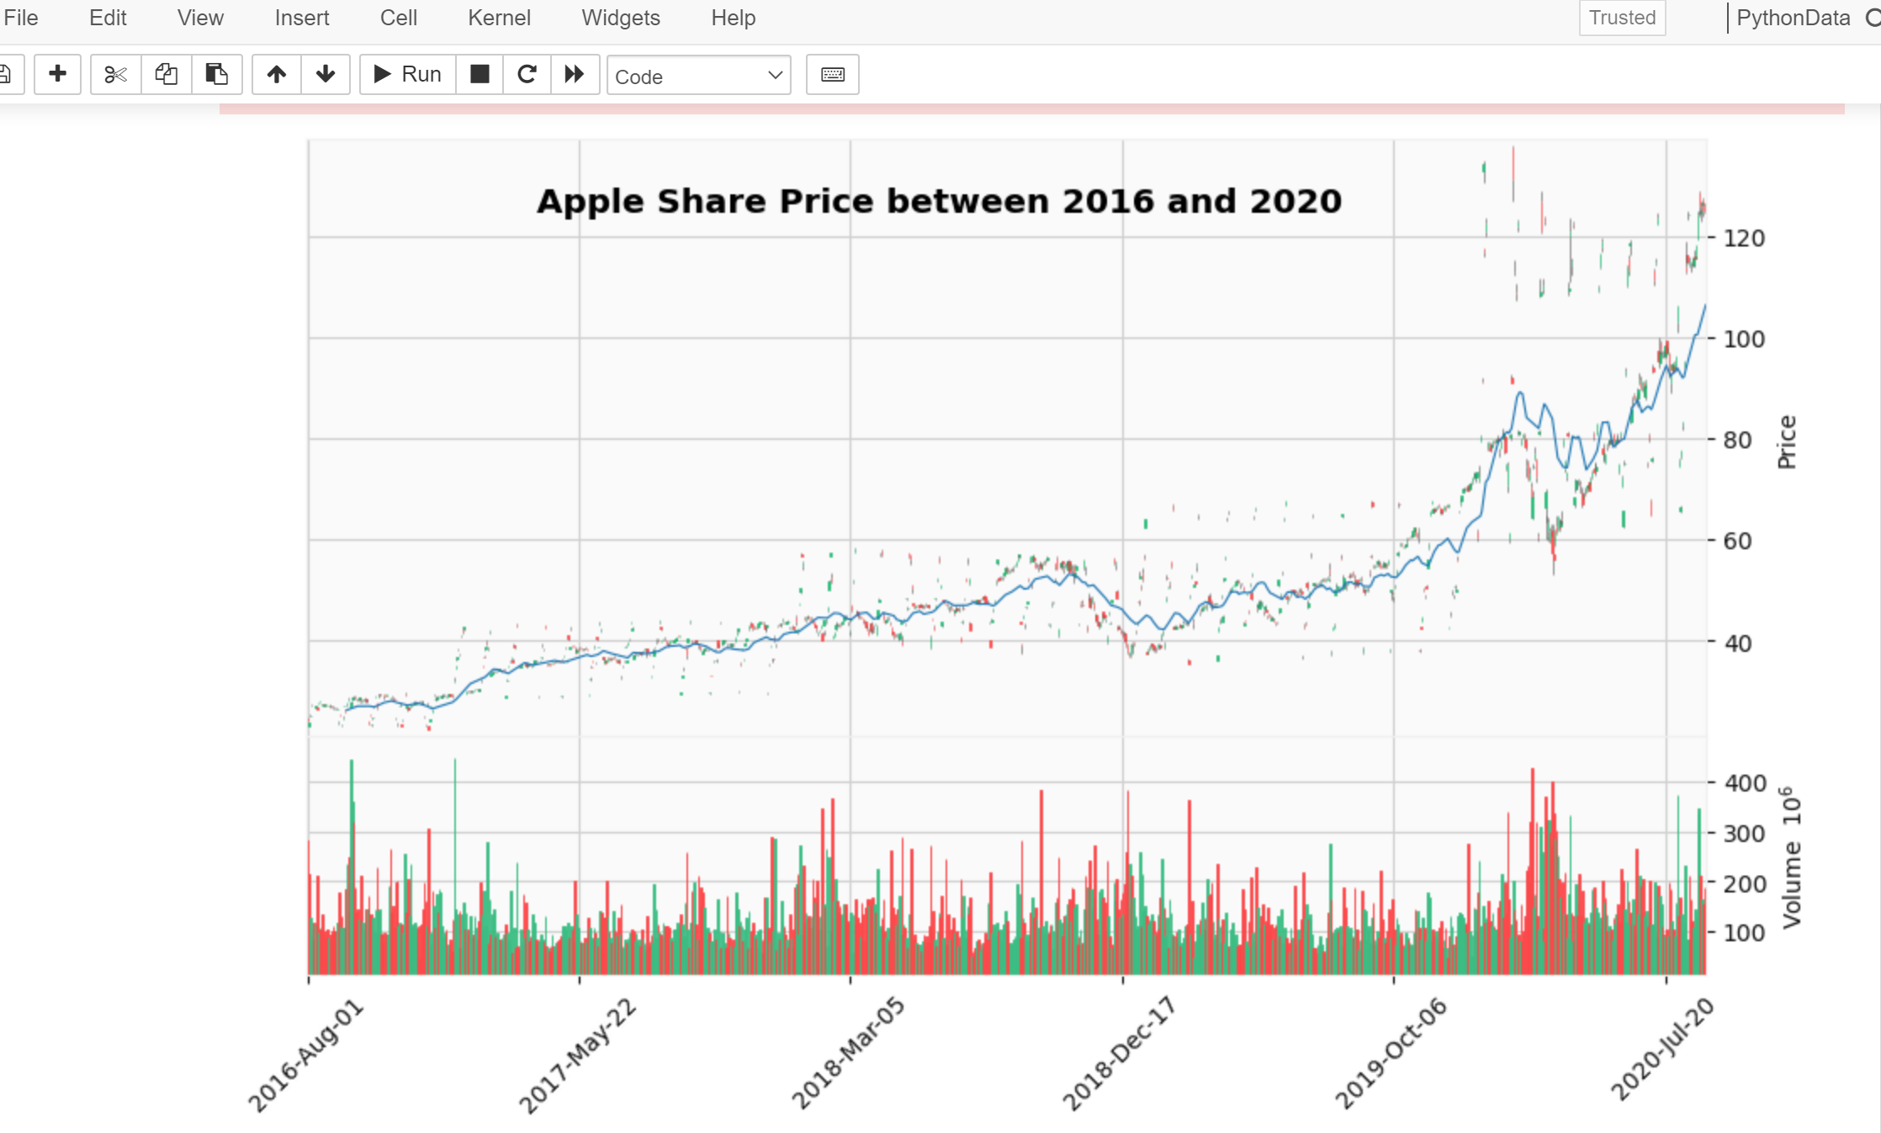
Candlestick Analysis
Steady increase in price over a period of 5 years
There’s usually a rise in volume at the beginning of every year until 2020 when there was a deep

Slide 23
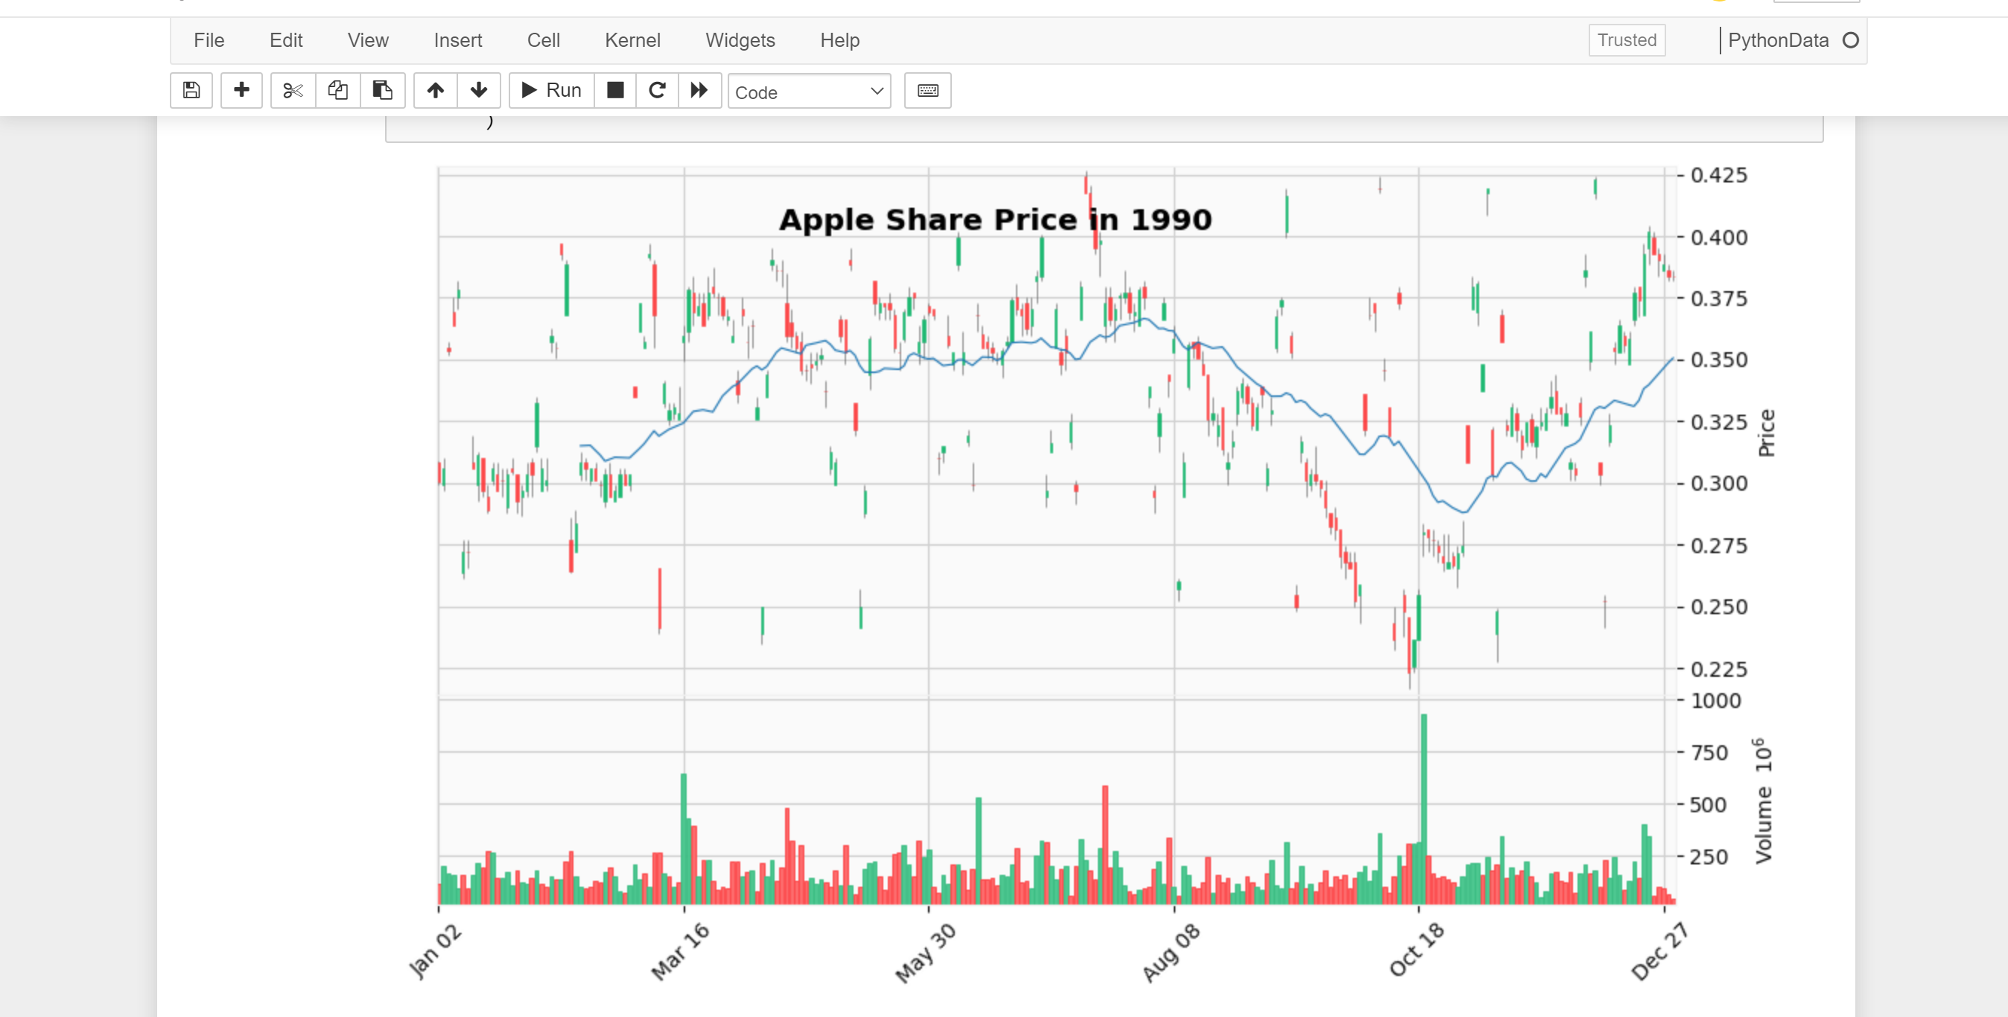
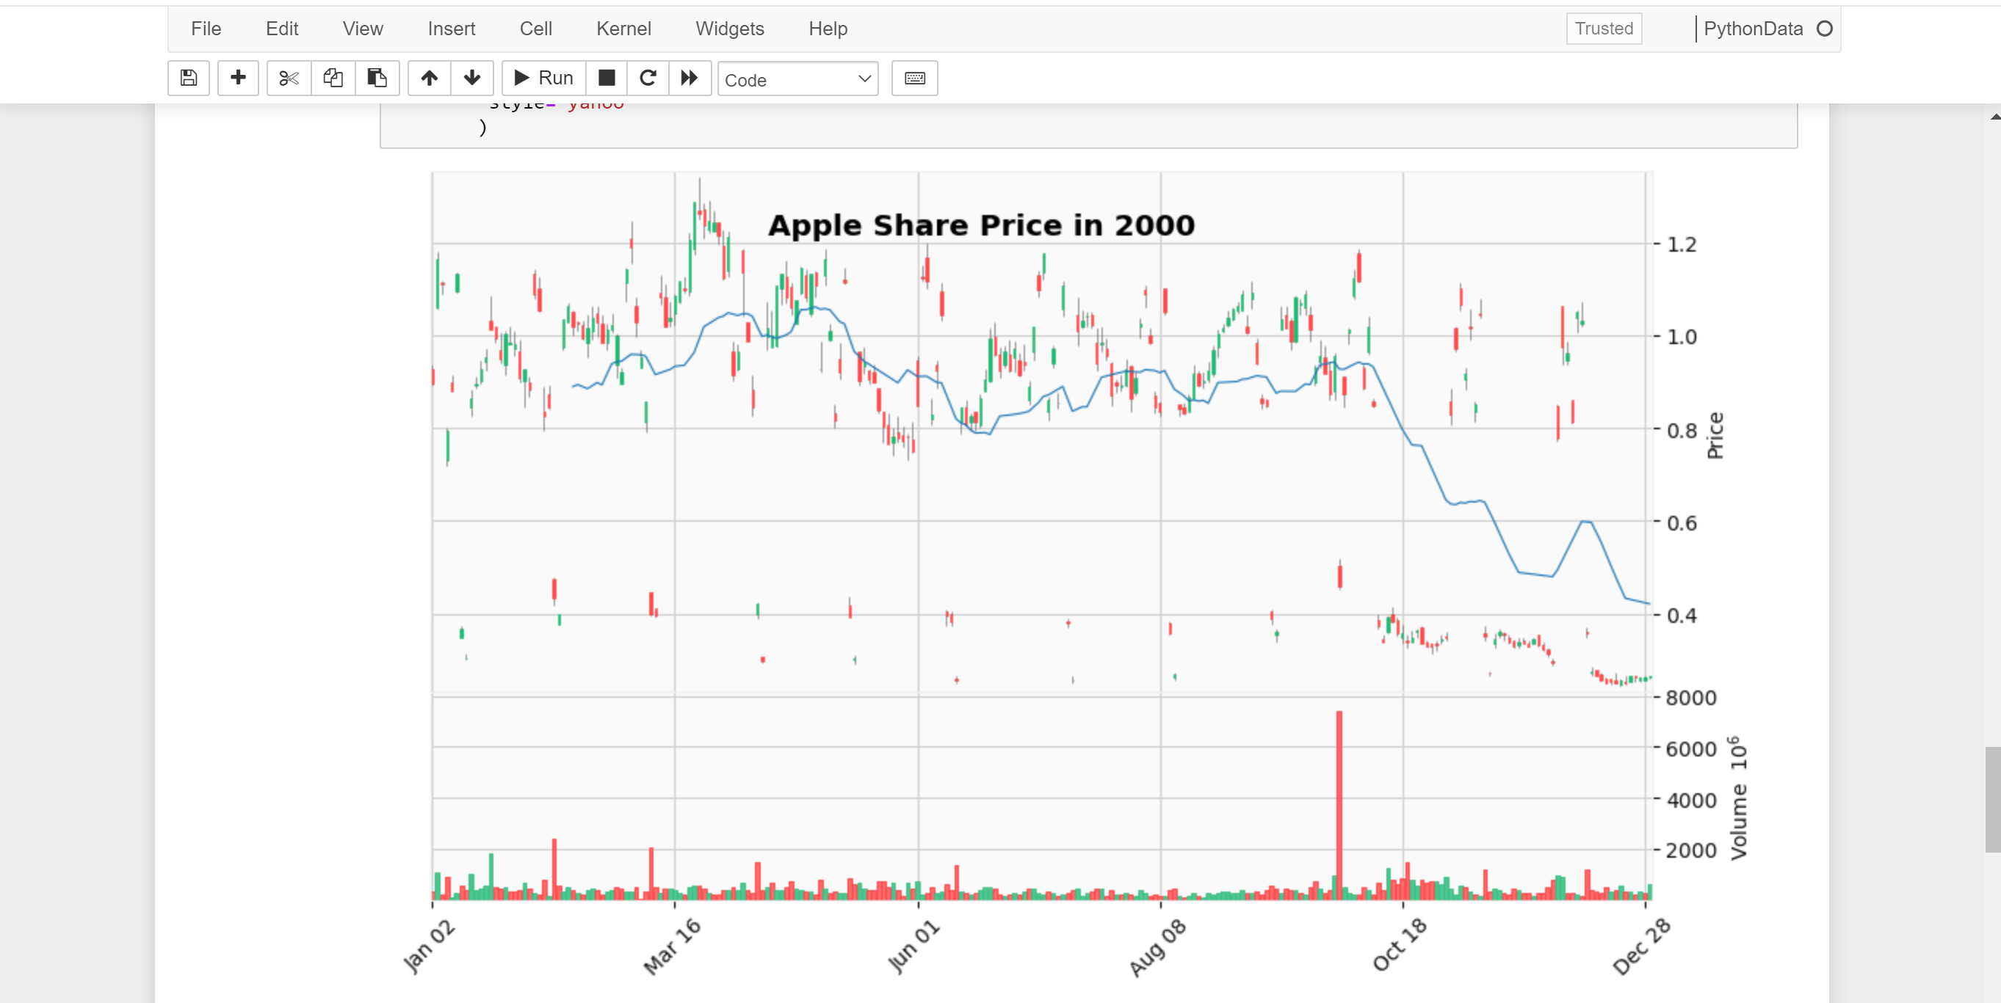
Price and Volume comparison between 1990 and 2000

Slide 24
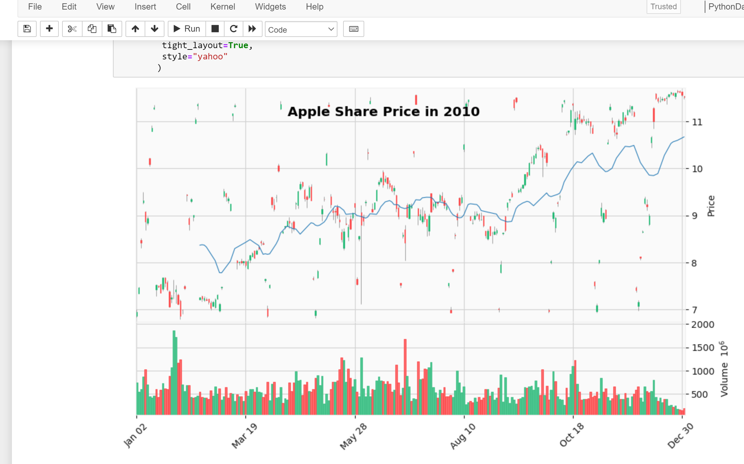
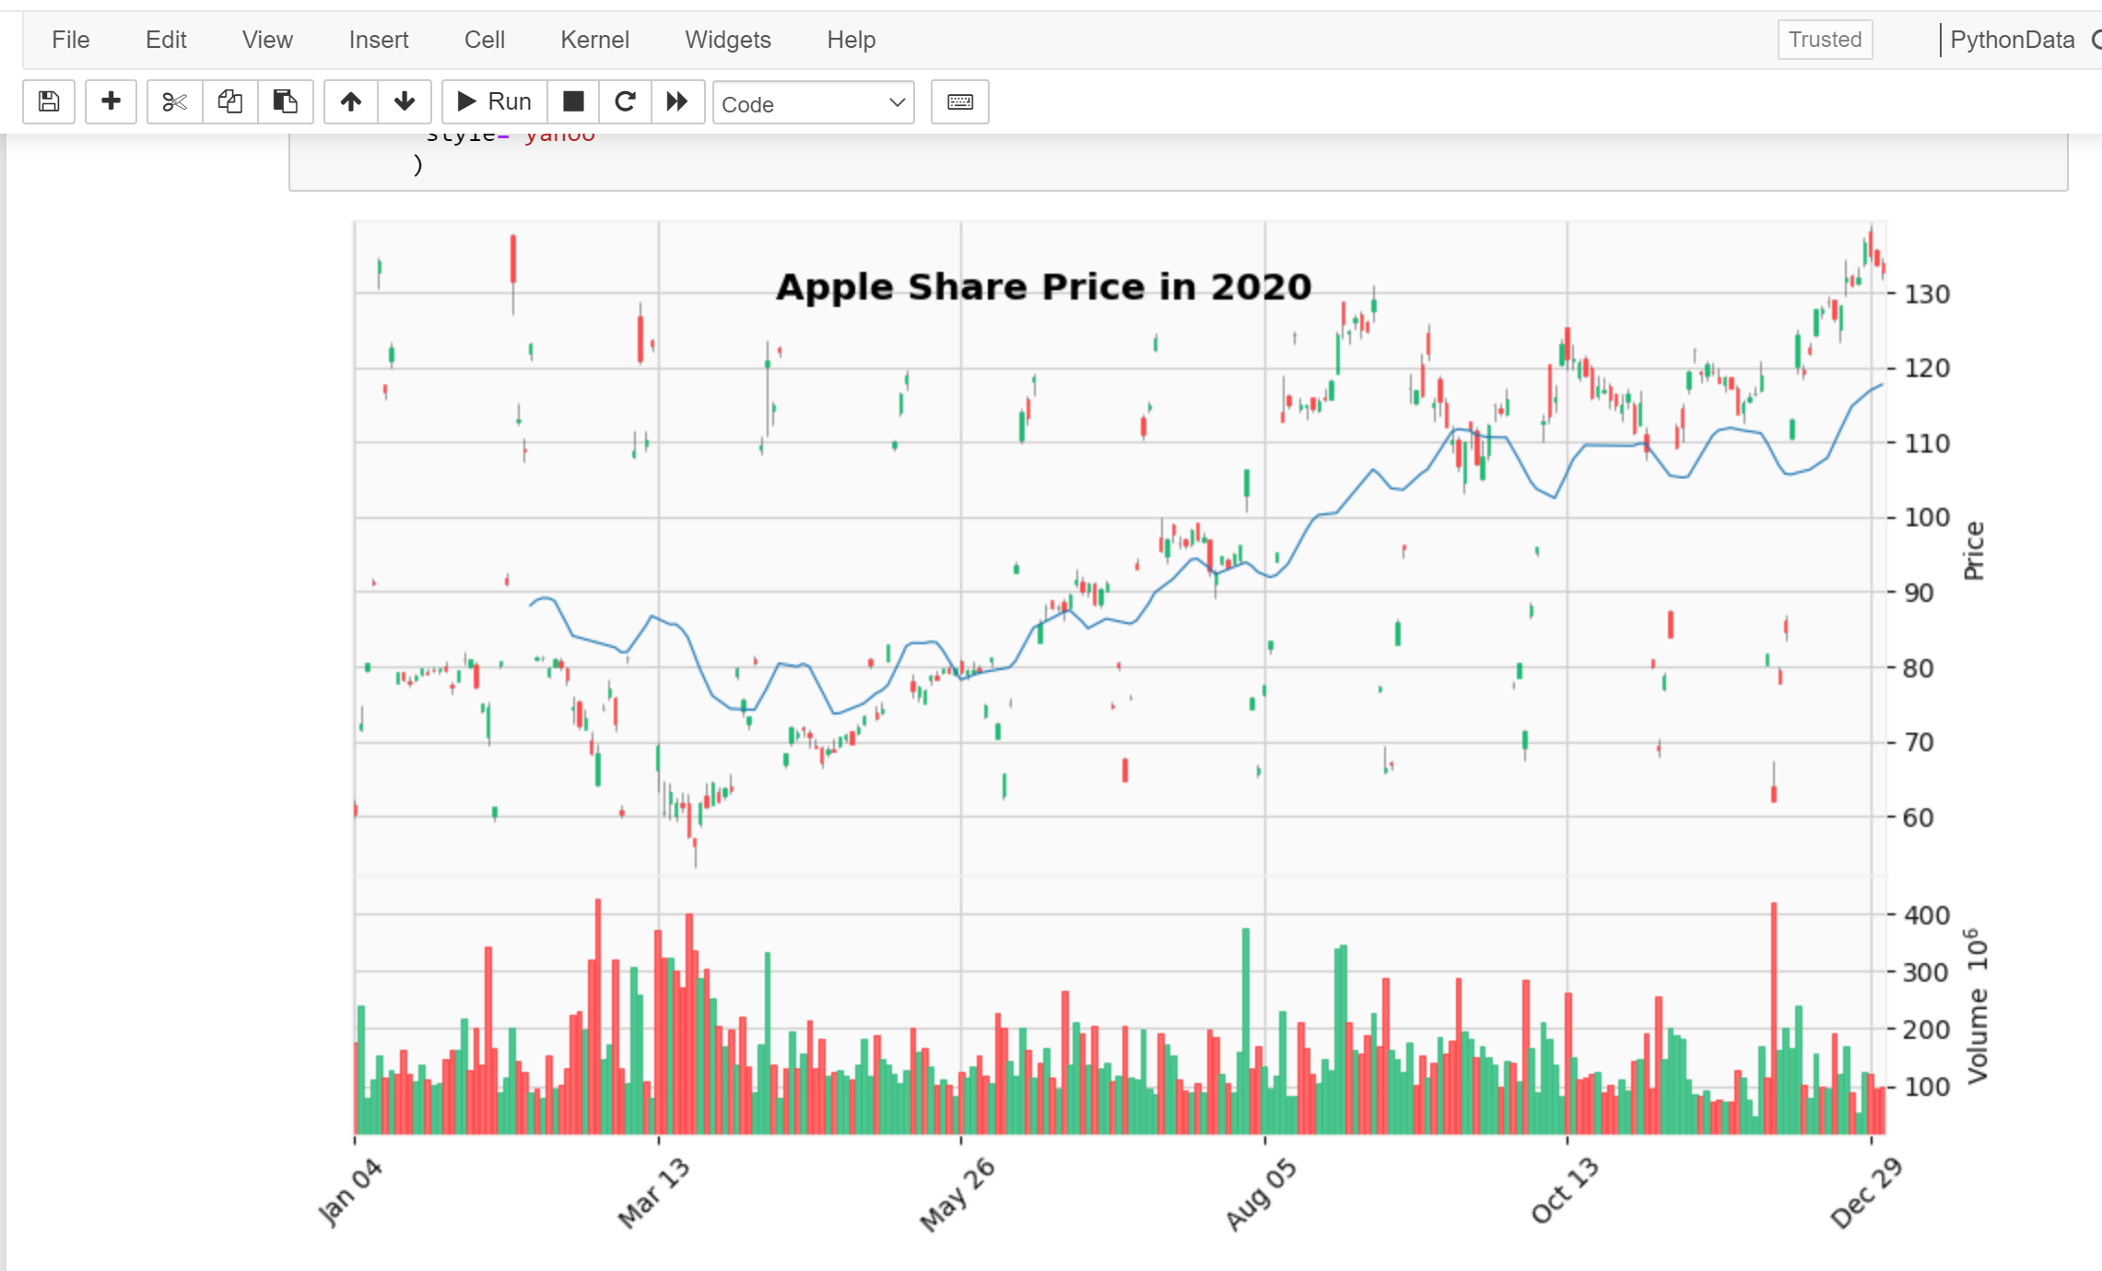
Price and Volume comparison between 2010 and 2020

Slide 25
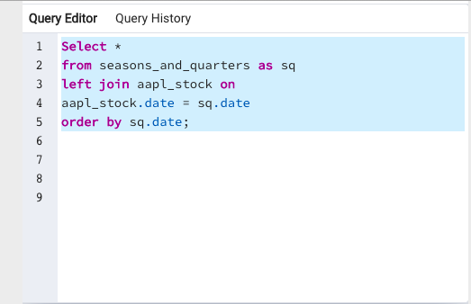
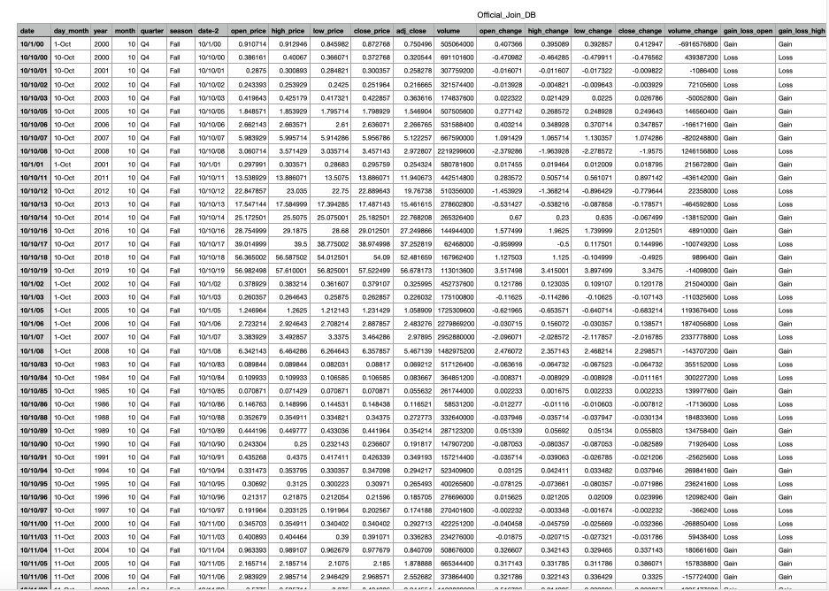
Database
The database was joined by using the query below using the Kaggle dataset and season and quarter dataset.

Slide 26
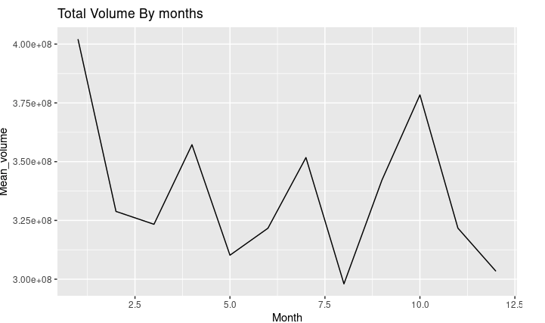
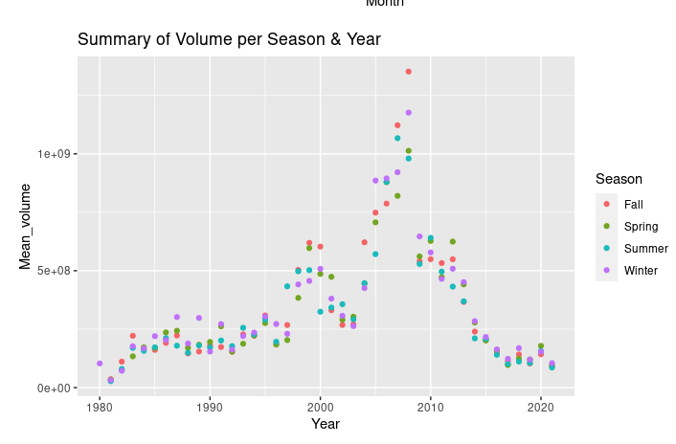
R-Analysis
Total Volume by months, year and seasons.

Slide 27
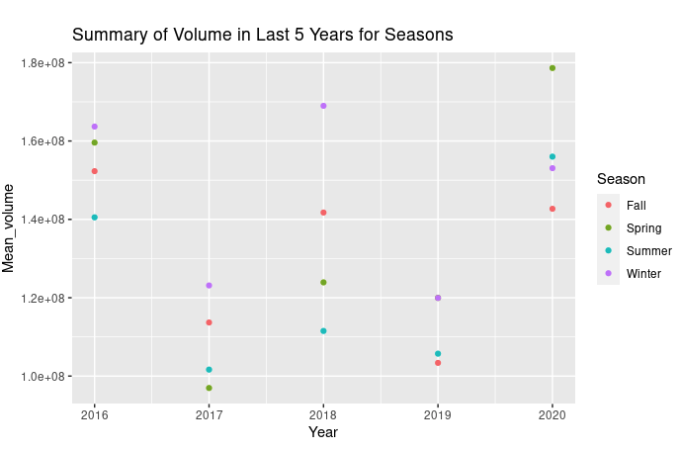
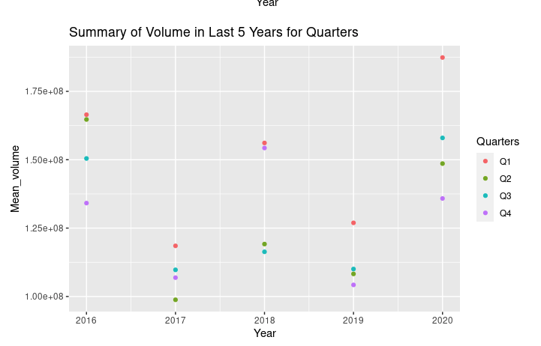
R-Analysis
Summary showing last 5 years volume price for seasons and quarters

